Slide 1
Multi-dimensional data model
Data Mining: Concepts and Techniques

Slide 2
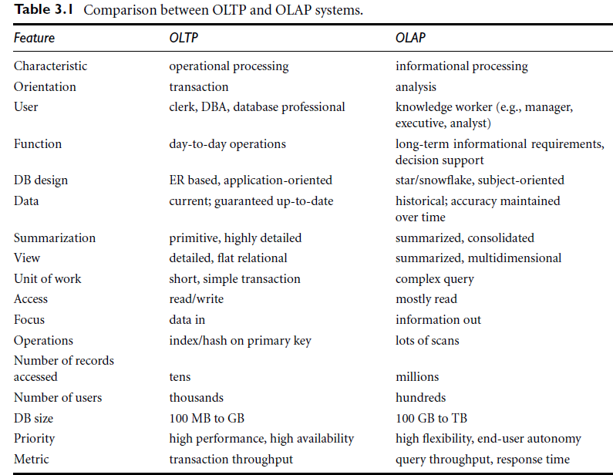

Slide 3
Multi-dimensional data model
The entity-relationship data model is commonly used in the design of relational databases, where a database schema consists of a set of entities and the relationships between them. Such a data model is appropriate for on-line transaction processing. The data warehouse requires concise, subject oriented schema that facilitates OLAP.
Data warehouses and OLAP tools are based on a multidimensional data model. This model views data in the form of a data cube

Slide 4
WHAT IS DATA CUBE?
A data cube allows data to be modeled and viewed in multiple dimensions. It is defined by dimensions and facts.
Dimensions are the entities with respect to which an organization wants to keep records.
Facts are numerical measures. It is the quantities by which we want to analyze relationships between dimensions.

Slide 5
A data warehouse is based on a multidimensional data model which views data in the form of a data cube
A data cube, such as sales, allows data to be modeled and viewed in multiple dimensions
  Dimension tables, such as item (item_name, brand, type), or time(day, week, month, quarter, year)
  Fact table contains measures (such as dollars_sold) and keys to each of the related dimension tables
In data warehousing literature, an n-D base cube is called a base cuboid. The top most 0-D cuboid, which holds the highest-level of summarization, is called the apex cuboid.
Data Mining: Concepts and Techniques

Slide 6
Cube: A Lattice of Cuboids
all
0-D(apex) cuboid
time
item
location
supplier
1-D cuboids
time,item
time,location
item,location
location,supplier
2-D cuboids
time,supplier
item,supplier
time,item,location
time,location,supplier
3-D cuboids
time,item,supplier
item,location,supplier
4-D(base) cuboid
time, item, location, supplier
Data Mining: Concepts and Techniques

Slide 7
Conceptual Modeling of Data Warehouses
Modeling data warehouses: dimensions & measures
  Star schema: A fact table in the middle connected to a set of dimension tables
  Snowflake schema: A refinement of star schema where some dimensional hierarchy is normalized into a set of smaller dimension tables, forming a shape similar to snowflake
  Fact constellations: Multiple fact tables share dimension tables, viewed as a collection of stars, therefore called galaxy schema or fact constellation
Data Mining: Concepts and Techniques

Slide 8
Data warehouse contains:
A large central table (fact table) containing the bulk of the data, with no redundancy, and
A set of smaller attendant tables (dimension tables), one for each dimension.
Data Mining: Concepts and Techniques

Slide 9
Example of Star Schema
time
time_key
day
day_of_the_week
month
quarter
year
item
item_key
item_name
brand
type
supplier_type
Sales Fact Table
time_key
item_key
branch_key
branch
location
location_key
branch_key
branch_name
branch_type
location_key
street
city
province_or_street
country
units_sold
dollars_sold
avg_sales
Measures
Data Mining: Concepts and Techniques

Slide 10
Example of Snowflake Schema
time
item
time_key
day
day_of_the_week
month
quarter
year
item_key
item_name
brand
type
supplier_key
supplier
Sales Fact Table
supplier_key
supplier_type
time_key
item_key
branch_key
branch
location
location_key
location_key
street
city_key
branch_key
branch_name
branch_type
units_sold
city
dollars_sold
city_key
city
province_or_street
country
avg_sales
Measures
Data Mining: Concepts and Techniques

Slide 11
Example of Fact Constellation
time
time_key
day
day_of_the_week
month
quarter
year
item
Shipping Fact Table
item_key
item_name
brand
type
supplier_type
Sales Fact Table
time_key
time_key
item_key
shipper_key
item_key
branch_key
from_location
branch
location_key
location
to_location
branch_key
branch_name
branch_type
units_sold
location_key
street
city
province_or_street
country
dollars_cost
dollars_sold
units_shipped
avg_sales
shipper
Measures
shipper_key
shipper_name
location_key
shipper_type
Data Mining: Concepts and Techniques

Slide 12
A Data Mining Query Language, DMQL: Language Primitives
Cube Definition (Fact Table)
  define cube <cube_name> [<dimension_list>]: <measure_list>
Dimension Definition ( Dimension Table )
  define dimension <dimension_name> as (<attribute_or_subdimension_list>)
Data Mining: Concepts and Techniques

Slide 13
Defining a Star Schema in DMQL
define cube sales_star [time, item, branch, location]:
    dollars_sold = sum(sales_in_dollars), avg_sales = avg(sales_in_dollars), units_sold = count(*)
define dimension time as (time_key, day, day_of_week, month, quarter, year)
define dimension item as (item_key, item_name, brand, type, supplier_type)
define dimension branch as (branch_key, branch_name, branch_type)
define dimension location as (location_key, street, city, province_or_state, country)
Data Mining: Concepts and Techniques

Slide 14
Defining a Snowflake Schema in DMQL
define cube sales_snowflake [time, item, branch, location]:
    dollars_sold = sum(sales_in_dollars), avg_sales = avg(sales_in_dollars), units_sold = count(*)
define dimension time as (time_key, day, day_of_week, month, quarter, year)
define dimension item as (item_key, item_name, brand, type, supplier(supplier_key, supplier_type))
define dimension branch as (branch_key, branch_name, branch_type)
define dimension location as (location_key, street, city(city_key, province_or_state, country))
Data Mining: Concepts and Techniques

Slide 15
CONCEPT HIERARCHY
A concept hierarchy defines a sequence of mappings from a set of low-level concepts to higher-level, more general concepts.

Slide 16
A Concept Hierarchy: Dimension (location)
all
all
region
Europe
...
North_America
country
Germany
...
Spain
Canada
...
Mexico
city
Frankfurt
...
Vancouver
...
Toronto
office
L. Chan
...
M. Wind
Data Mining: Concepts and Techniques

Slide 17


View of Warehouses and Hierarchies
Specification of hierarchies
Schema hierarchy
  day < {month < quarter; week} < year
Set_grouping hierarchy
  {1..10} < inexpensive
Data Mining: Concepts and Techniques

Slide 18
Multidimensional Data
Sales volume as a function of product, month, and region
Dimensions: Product, Location, Time
Hierarchical summarization paths
Region
Industry Region Year
Category Country Quarter
Product City Month Week
Office Day
Product
Month
Data Mining: Concepts and Techniques

Slide 19
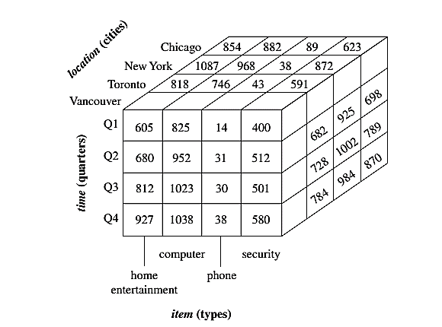
Multidimensional Data

Slide 20

A Sample Data Cube
Date
Total annual sales
of TV in U.S.A.
1Qtr
2Qtr
3Qtr
4Qtr
sum
Product
TV
PC
U.S.A
VCR
sum
Canada
Country
Mexico
sum
All, All, All
Data Mining: Concepts and Techniques

Slide 21
Cuboids Corresponding to the Cube
all
0-D(apex) cuboid
product
date
country
1-D cuboids
product,date
product,country
date, country
2-D cuboids
3-D(base) cuboid
product, date, country
Data Mining: Concepts and Techniques

Slide 22
OLAP Operations in the Multidimensional Data Model
In the multidimensional model, data are organized into multiple dimensions, and each dimension contains multiple levels of abstraction defined by concept hierarchies.
Organization provides users with the flexibility to view data from different perspectives. A number of OLAP data cube operations exist to materialize these different views, allowing interactive querying and analysis of the data at hand

Slide 23
Typical OLAP Operations
Roll up (drill-up): summarize data
  by climbing up hierarchy or by dimension reduction
Drill down (roll down): reverse of roll-up
  from higher level summary to lower level summary or detailed data, or introducing new dimensions
Slice and dice:
  project and select
The Slice operation performs a selection on one dimension of the given cube, resulting in a subcube. The dice operation defines a subcube by performing a selection on two or more dimensions.
Pivot (rotate):
  reorient the cube, visualization, 3D to series of 2D planes.
Data Mining: Concepts and Techniques

Slide 24
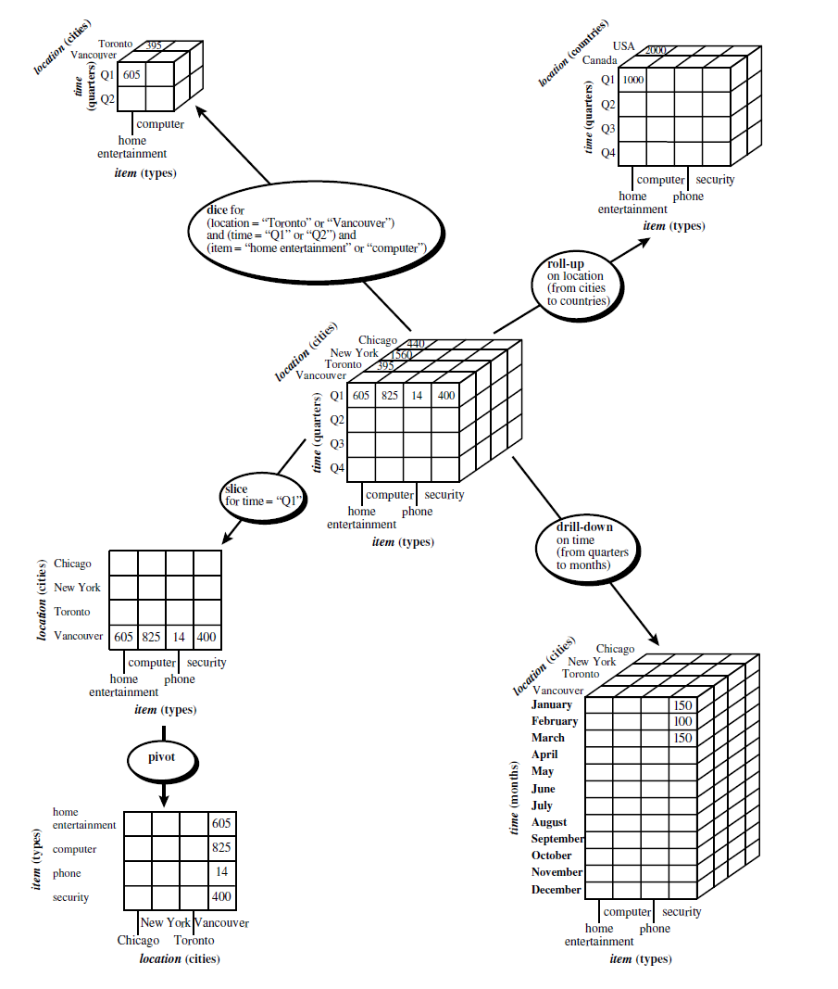
Data Mining: Concepts and Techniques

Slide 25
Data Warehouse Architecture
The Design of a Data Warehouse: A Business Analysis Framework
“What can business analysts gain from having a data warehouse?”
1. Competitive advantage (by presenting relevant information to help win over competitors).
2. Data warehouse can enhance business productivity (because it is able to quickly and efficiently gather information that accurately describes the organization.).

Slide 26
Data Warehouse Architecture
3. Data warehouse facilitates customer relationship management (because it provides a consistent view of customers and items across all lines of business, all departments, and all markets).
4. Cost reduction by tracking trends, patterns, and exceptions over long periods in a consistent and reliable manner.
To design an effective data warehouse we need to understand and analyze business needs and construct a business analysis framework.

Slide 27
Views in data warehouse design
Four different views regarding the design of a data warehouse must be considered:
The top-down view allows the selection of the relevant information necessary for the data warehouse. This information matches the current and future business needs.
The data source view exposes the information being captured, stored, and managed by operational systems.

Slide 28
Views in data warehouse design
The data warehouse view includes fact tables and dimension tables. It represents the information that is stored inside the data warehouse.
The business query view is the perspective of data in the data warehouse from the viewpoint of the end user.

Slide 29
Building and using a data warehouse is a complex task because it requires business skills, technology skills, and program management skills.
Business skills- how such systems store and manage their data, how to build extractors that transfer data from the operational system to the data warehouse, and how to build warehouse refresh software, that keeps the data warehouse reasonably up-to-date with the operational system’s data

Slide 30
Technology skills, data analysts are required to understand how to make assessments from quantitative information and derive facts based on conclusions from historical information in the data warehouse. These skills include the ability to discover patterns and trends.
Program management skills involve the need to interface with many technologies, vendors, and end users in order to deliver results in a timely and cost-effective manner.

Slide 31
Process of Data Warehouse Design
Data warehouse can be built using a
top-down approach,
bottom-up approach, or
combination of both.

Slide 32
Process of Data Warehouse Design
Top-down approach starts with the overall design and planning. It is used where technology is mature and well known & business problems that must be solved are clear and well understood.
Bottom-up approach starts with experiments and prototypes. Useful in the early stage of business modeling and technology development.

Slide 33
Process of Data Warehouse Design
Combined approach, an organization can exploit the planned and strategic nature of the top-down approach while retaining the rapid implementation and opportunistic application of the bottom-up approach.

Slide 34
In general, the warehouse design process consists of the following steps:
Choose a business process to model (e.g., orders, invoices, shipments, inventory, account administration, sales, or the general ledger).
Choose the business process grain, which is the fundamental, atomic level of data to be represented in the fact table for this process (e.g., individual transactions, individual daily snapshots, and so on).
Choose the dimensions that will apply to each fact table record.
Choose the measures that will populate each fact table record. Typical measures are numeric additive quantities like dollars_sold and units_ sold.

Slide 35
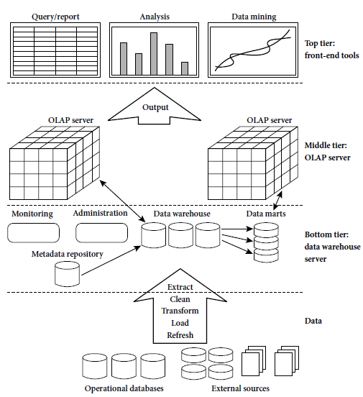
Three-Tier Data Warehouse Architecture

Slide 36
Bottom tier is a warehouse database server that is almost always a relational database system. Back-end tools and utilities are used to feed data into the bottom tier from operational databases or other external sources. The data are extracted using application program interfaces known as gateways.
Middle tier is an OLAP server that is typically implemented using either (1) a relational OLAP (ROLAP) model, that is, an extended relational DBMS that maps operations on multidimensional data to standard relational operations; (2) MOLAP (i.e., a special-purpose server that directly implements multidimensional data and operations).

Slide 37
Top tier is a front-end client layer, which contains query and reporting tools, analysis tools, and/or data mining tools (e.g., trend analysis, prediction, and so on).
From the architecture point of view, there are three data warehouse models: the enterprise warehouse, the data mart, and the virtual warehouse.

Slide 38
“What are the pros and cons of the top-down and bottom-up approaches to data warehouse development?”
TOP DOWN- it is expensive, takes a long time to develop, and lacks flexibility due to the difficulty in achieving consistency.
Bottom-up approach to the design, development, and deployment of independent data marts provides flexibility, low cost, and rapid return of investment.

Slide 39
Integrating various disparate data marts into a consistent enterprise data warehouse.
A recommended method for the development of data warehouse systems is to implement the warehouse in an incremental and evolutionary manner

Slide 40
Three Data Warehouse Models
Enterprise warehouse
  collects all of the information about subjects spanning the entire organization
Data Mart
  a subset of corporate-wide data that is of value to a specific groups of users. Its scope is confined to specific, selected groups, such as marketing data mart
    Independent vs. dependent (directly from warehouse) data mart
Virtual warehouse
  A set of views over operational databases
  Only some of the possible summary views may be materialized

Slide 41
Data Warehouse Development: A Recommended Approach
Multi-Tier Data Warehouse
Distributed Data Marts
Enterprise Data Warehouse
Data Mart
Data Mart
Model refinement
Model refinement
Define a high-level corporate data model

Slide 42
Metadata Repository
Meta data is the data defining warehouse objects. It stores:
Description of the structure of the data warehouse
  schema, view, dimensions, hierarchies, derived data defn, data mart locations and contents
Operational meta-data
  data lineage (history of migrated data and transformation path), currency of data (active, archived, or purged), monitoring information (warehouse usage statistics, error reports, audit trails)
The algorithms used for summarization
The mapping from operational environment to the data warehouse
Data related to system performance
  warehouse schema, view and derived data definitions
Business data
  business terms and definitions, ownership of data, charging policies

